Slide 1
Seven Towering Achievements of KnowRisk’s Knowledge Base
The achievements which can change how the corporate risks are managed

Slide 2
Database VS Knowledge Base
V
S
Generic Database
Knowledge
Base
All risk management software store risks in databases.
Vendors, caught in the whirlwind of hyperbole, end up referring to that database erroneously as The Knowledge Base.
Knowledge Base is a constellation of risks that can easily be configured. It represents risks at every stage of risk management; ultimately providing an enriched classification system through a multidimensional view of the risk universe.

Slide 3
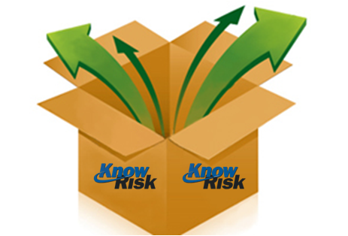
1. Knowledge Base has a pre-configured database with commonly encountered risks which can be used straight out of the box.
Academic Misconduct
Poor Ventilation
Social Licence to Operate
Identity theft &
Exploitation

Slide 4
2. It is common that most companies, especially at the initial stage, have risk data either in Excel or in some other electronic format. This data can be imported to the Knowledge base. Once the data is imported the user has the choice to scrutinize, reclassify it, and modify it before it is fit for final use. Till then and even thereafter it can be kept as a transit repository of risk data. It is only when the management is fully satisfied; the cured data can be moved around and accepted for use.
Final Use
Transit Repository

Slide 5
3. Collecting data through workshop, a brain storming session is the best way to capture collective wisdom. This data can be stored in the Knowledge Base and subjected to the same process as data secured from any other external source. The point to note is (in both cases of Excel and workshop wisdom), the risk data is isolated and kept as a separate and distinct activity for ultimate use.
Collective Wisdom
Final Use
Transit Repository

Slide 6
4. Knowledge Base can maintain the list of retired risks for the future reference. A handy feature if you wanted to resurrect any or some.
Retired Risks
Resurrected Risks

Slide 7
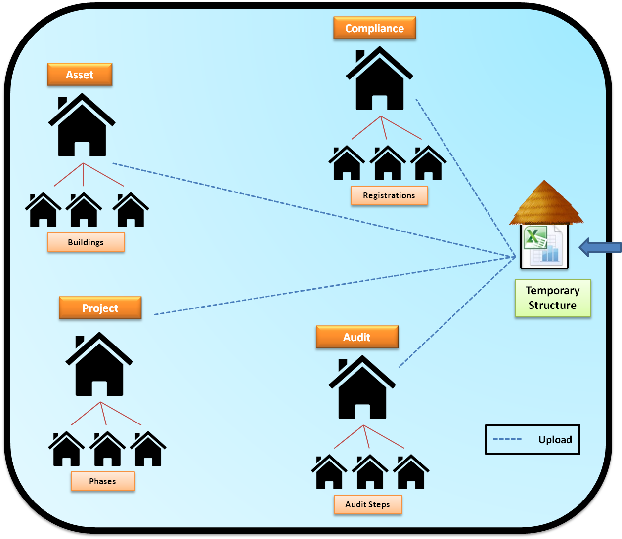
5. Consider the Knowledge Base as a constellation of buildings all linked with each other. It is difficult to move physical buildings from one location to another. However in the Knowledge Base paradigm, you can move them from one location to another defining their rightful place within the risk universe.

Slide 8
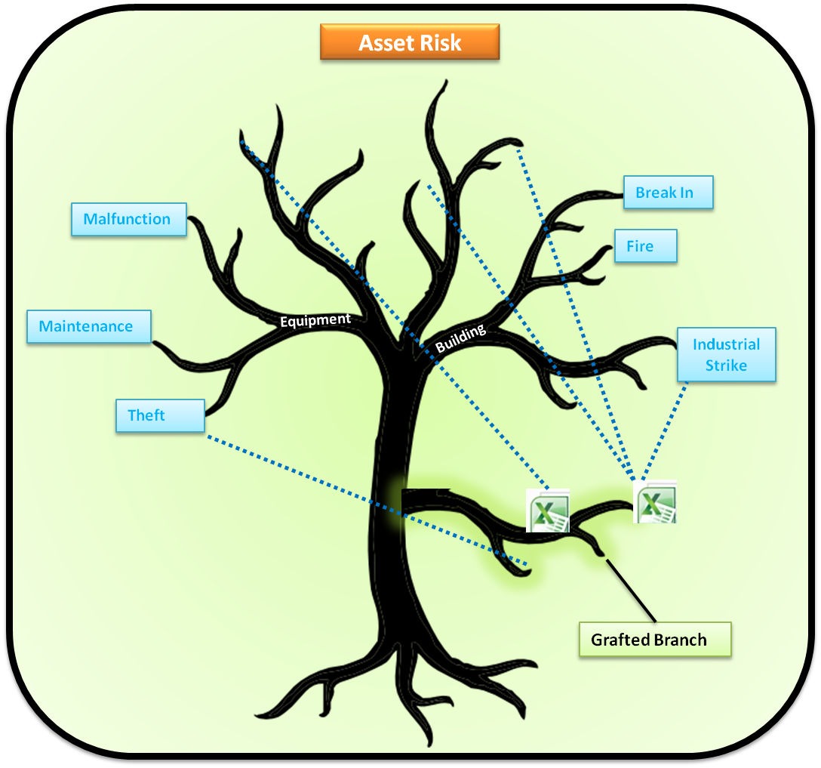
6. Consider Knowledge Base as a gigantic tree with branches within the branches. It is inconceivable to move the branches from one location to another. In the Knowledge Base paradigm, you can move them, reorder them, in effect you can construct a completely new risk tree

Slide 9
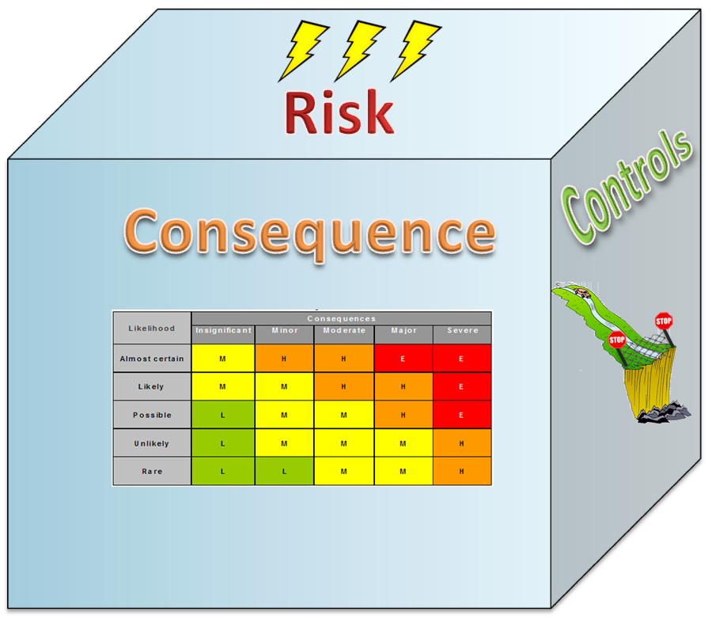
7. Risk is multi-dimensional. It has intertwined causes, consequences and controls to start with. Knowledge Base provides this composite view which a simple database cannot.

Slide 10
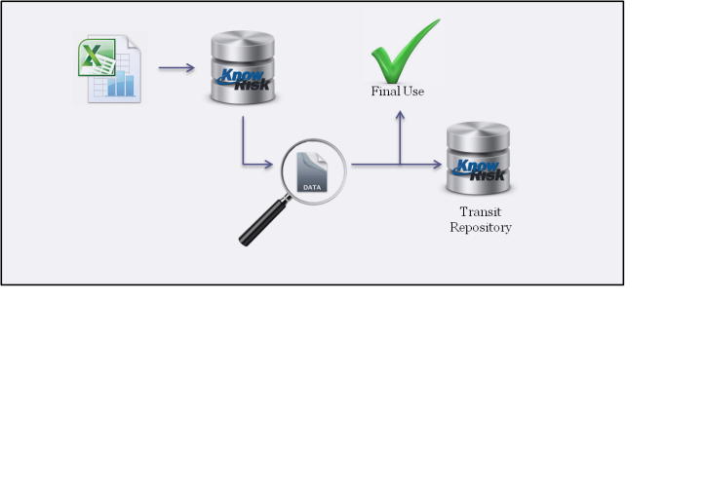
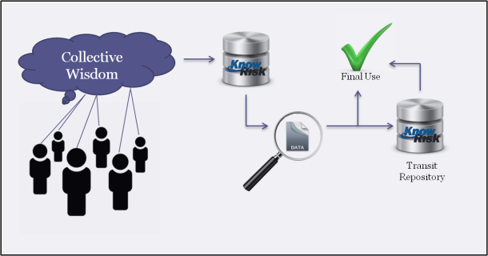
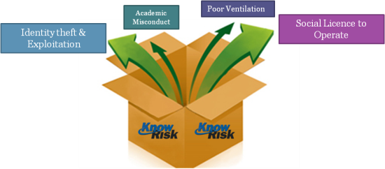
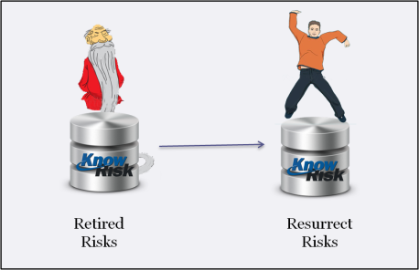
Summing it all up
Pre-configured Commonly Encountered Risks Straight Out of the Box
Import, Configure and Store data from Excel until ready for Final Use
Import, Configure and Store data from Workshop Brainstorming until ready for Final Use
Constellation of Risks that are
Easily Configurable
Represent Risk at Every Stage
Resurrect Retired Data
Multidimensional View of Risk
| Constellation of Risks
|Represents Risk at Every Stage
|Enriched Classification System
|Multidimensional
View
This is KnowRisk’s Knowledge Base.

